Slide 1
Deconvolution of RTD for compartment models via CNNs
Tuana Oyuncu
15/08/2024

Slide 2

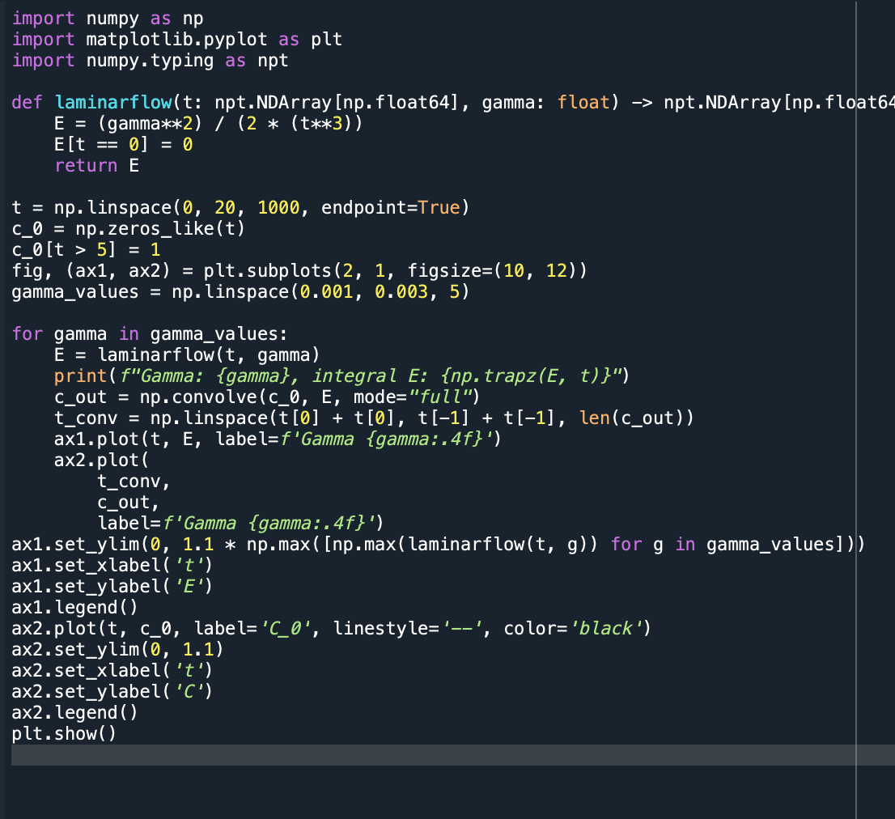
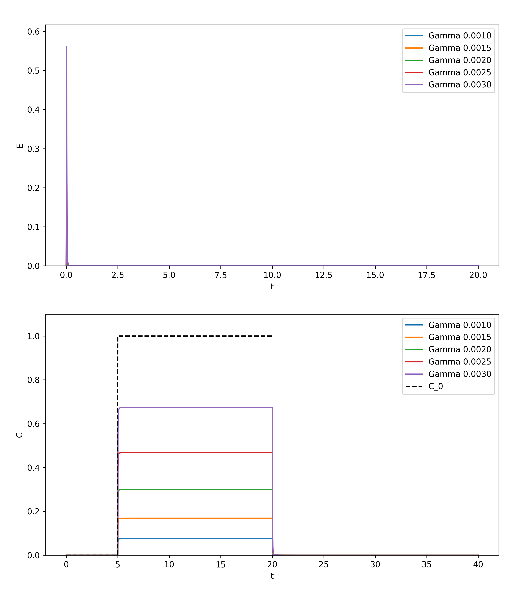
The Convection Model For Laminar Flow
Gamma
Laminarflow

Slide 3
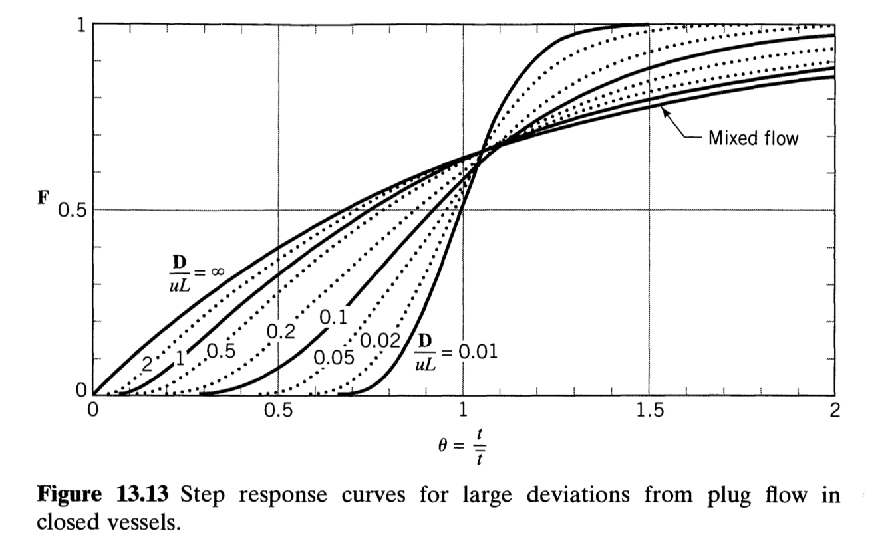


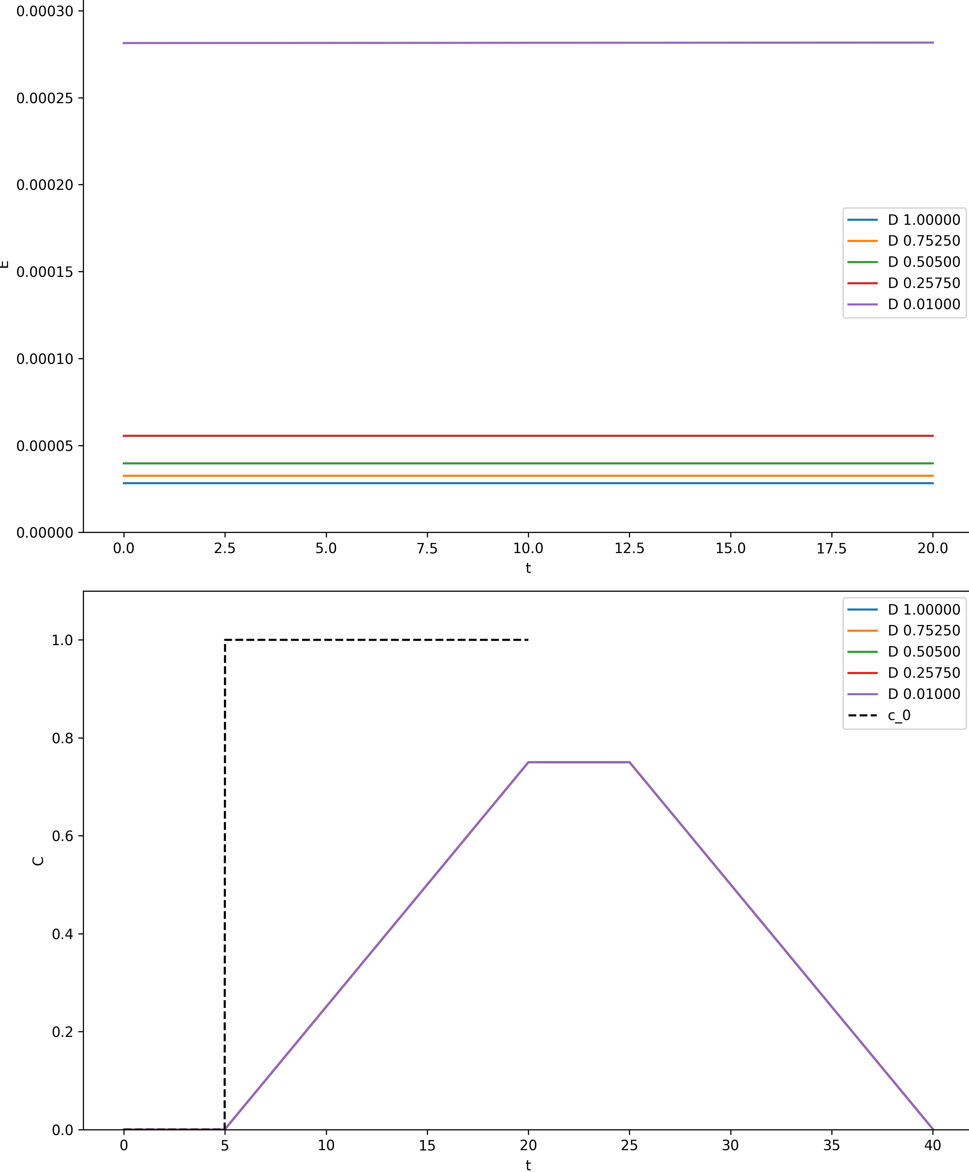
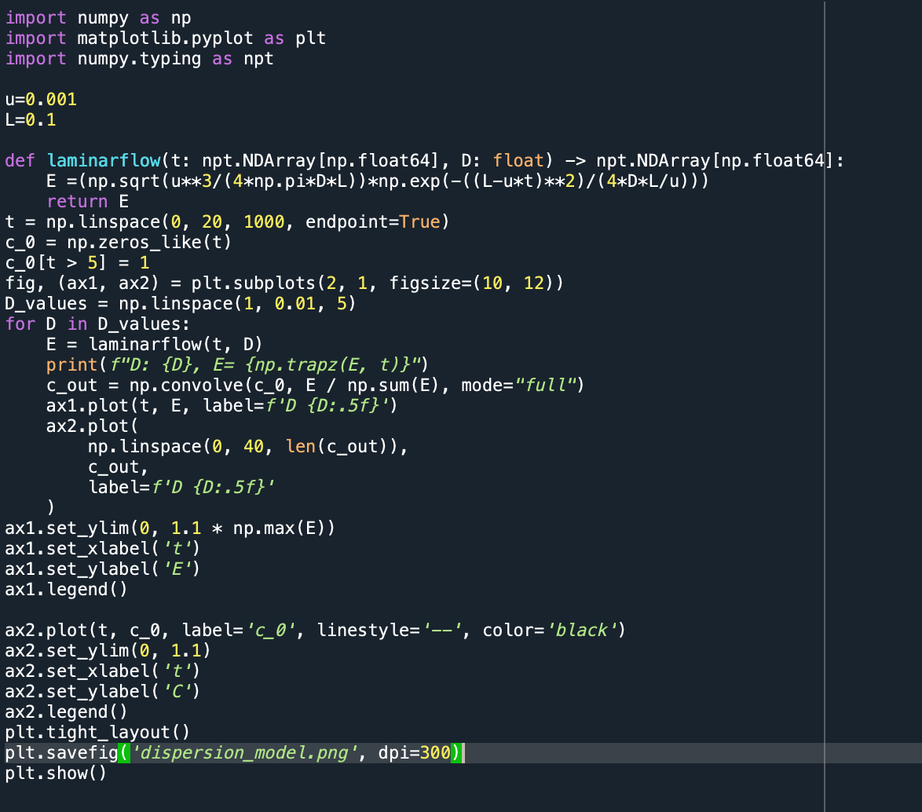
Dispersion Model
Do I need to normalize it?

Slide 4
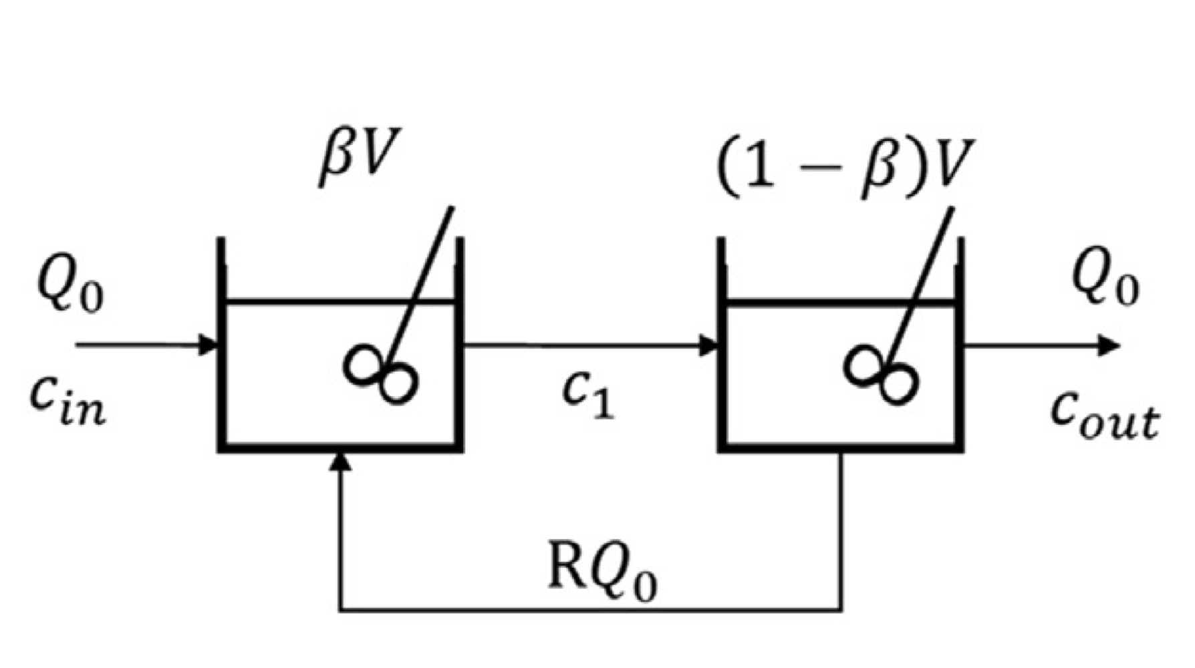

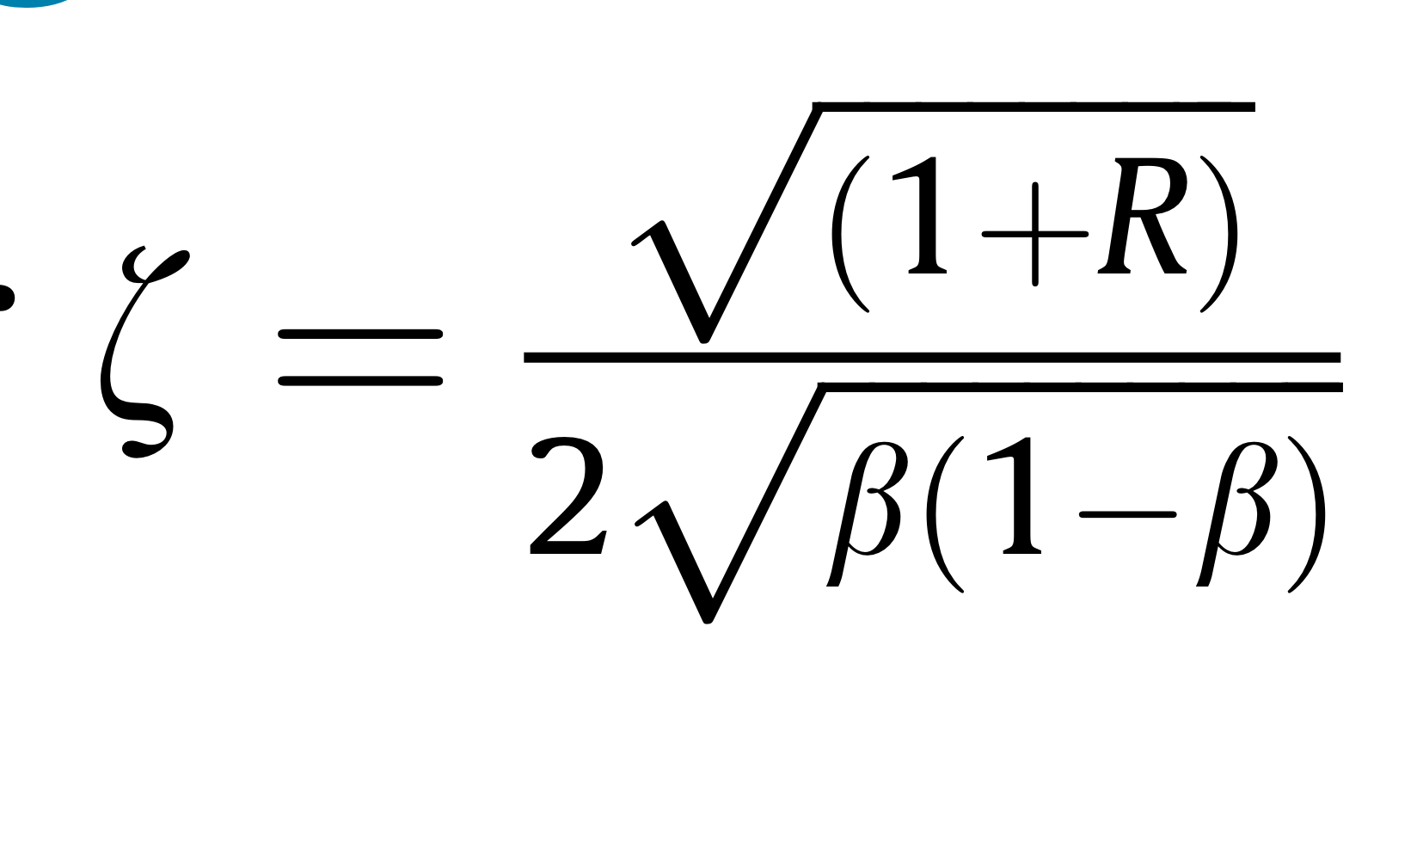
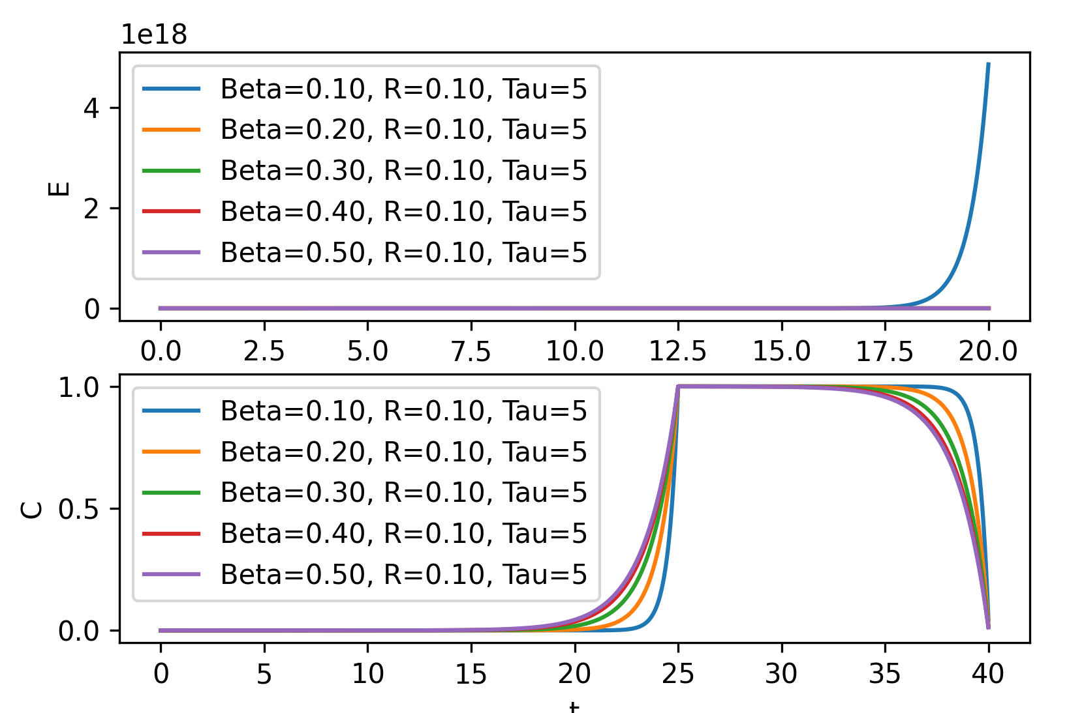
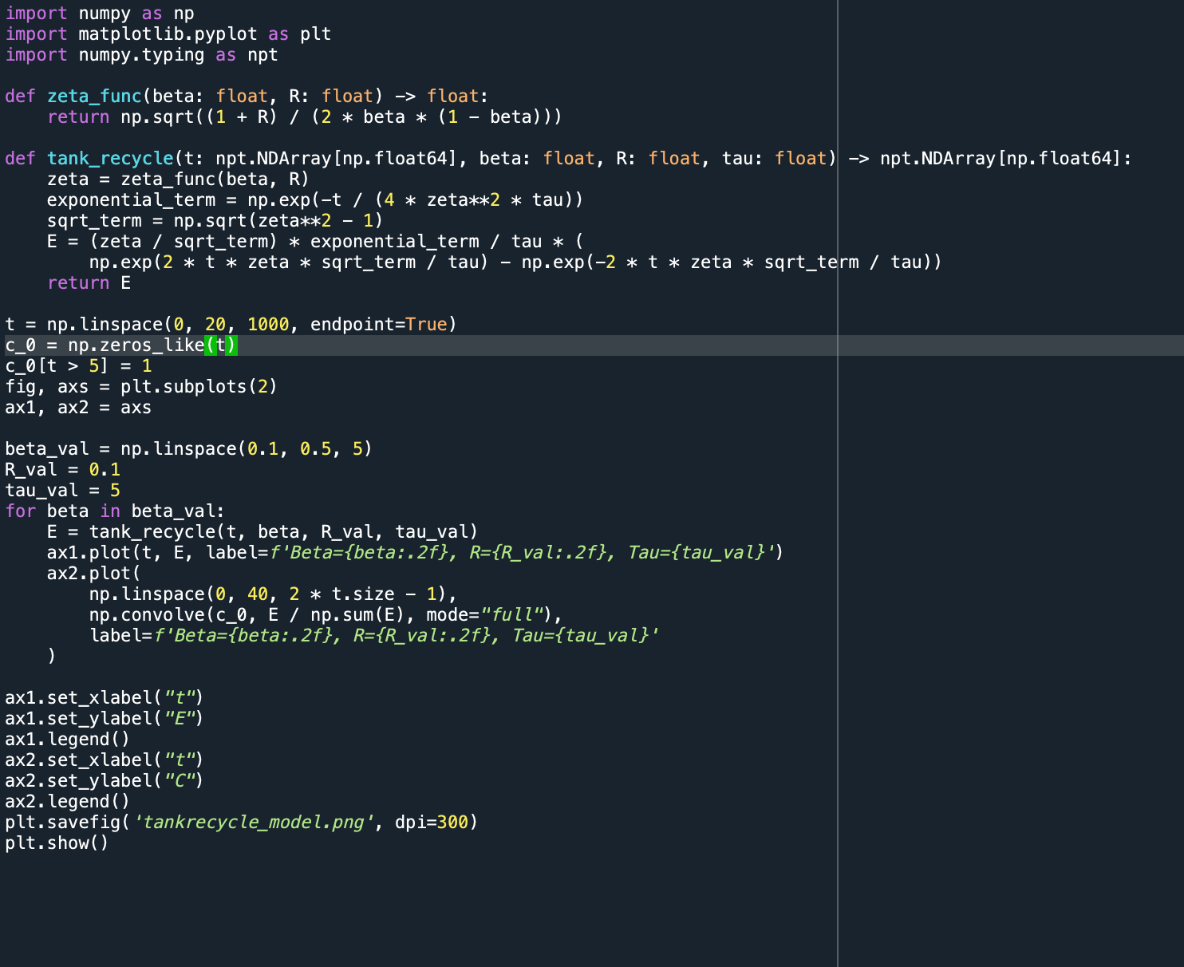
Tank in series with recycle
☺

Slide 5
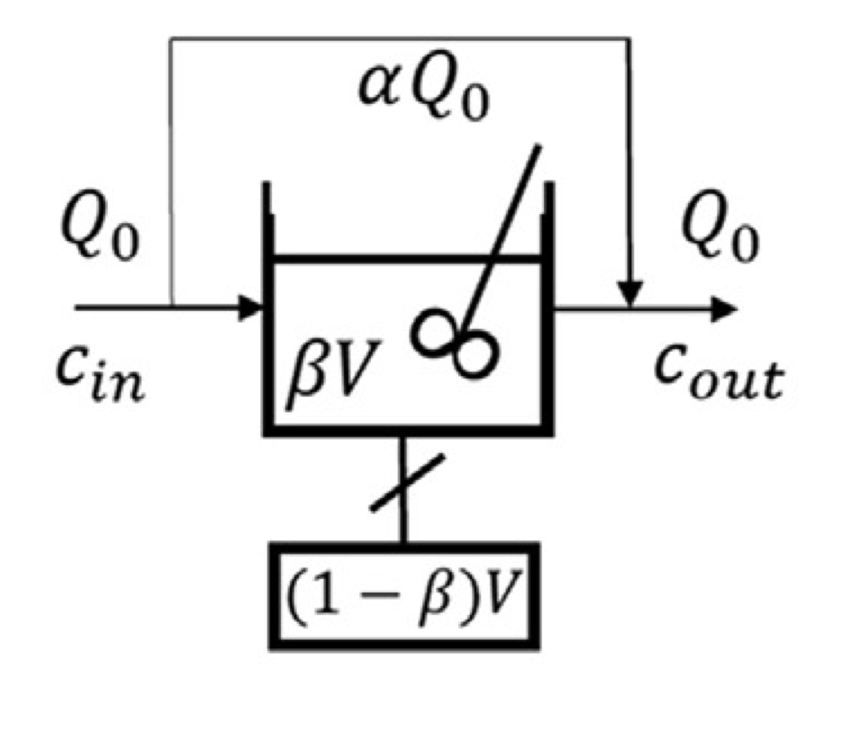

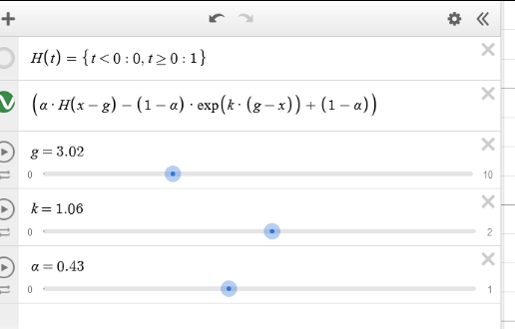

Cholete and Clautier

Slide 6



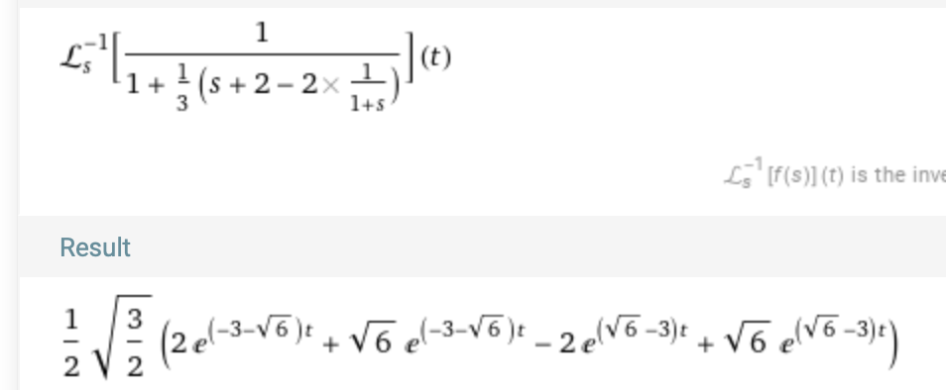
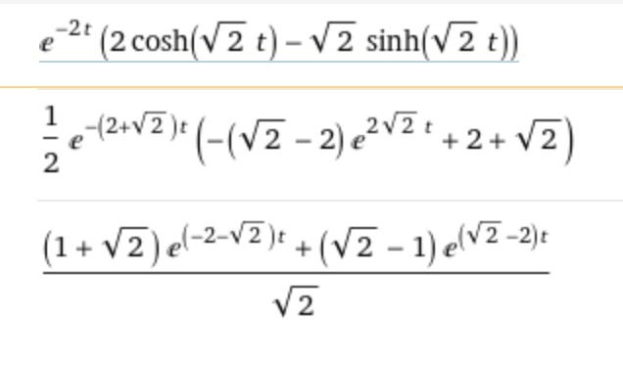
The unified time delay model
J=2
Tau=1
Alfa=1
Inverse Laplace transform
How can I be sure about the coefficients

Slide 7
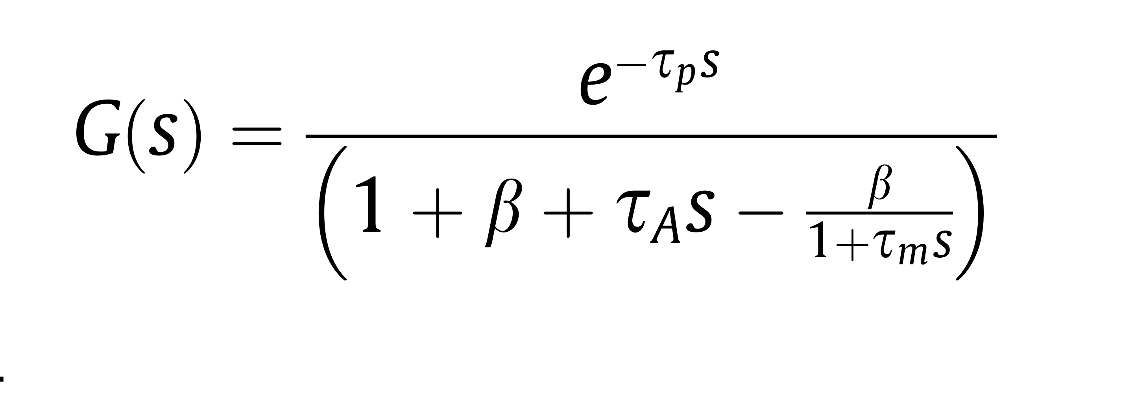
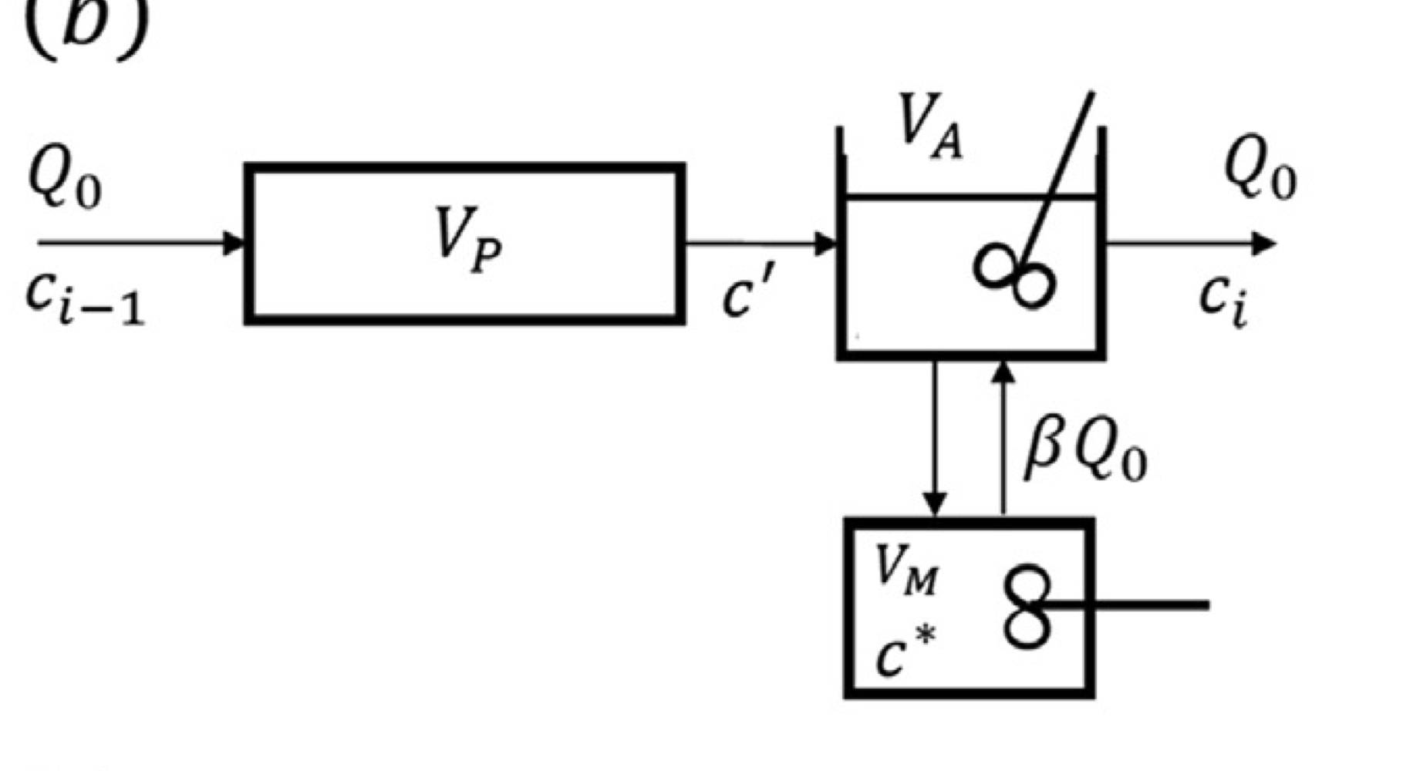
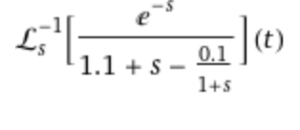

Adler and Hovorka
All =1
Except beta=0.1

Slide 8
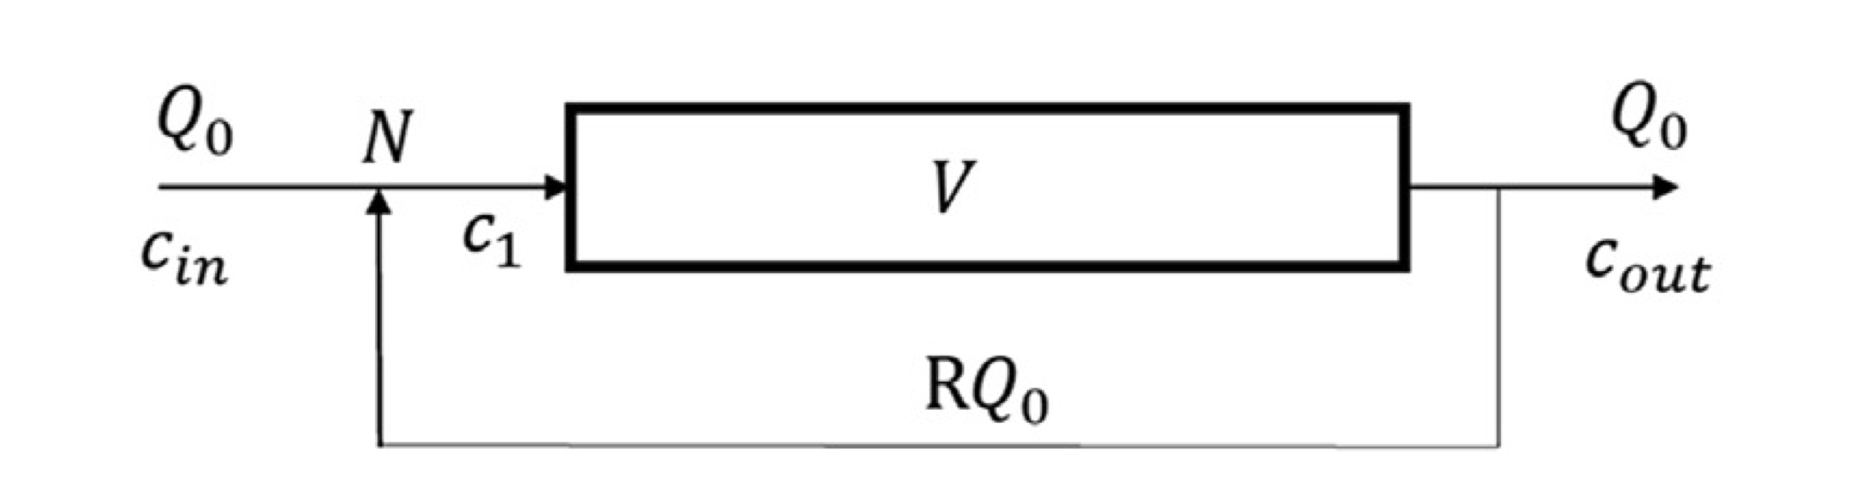

Plug Flow with Recycle

Slide 9

Ganttchart

Slide 10
THANK YOU! I would like to thank Prof. Dr.-Ing. Robert Güttel, M.Sc. Hannes Stagge and M.Sc. Max Gäßler for their guidance and support.

